Slide 1
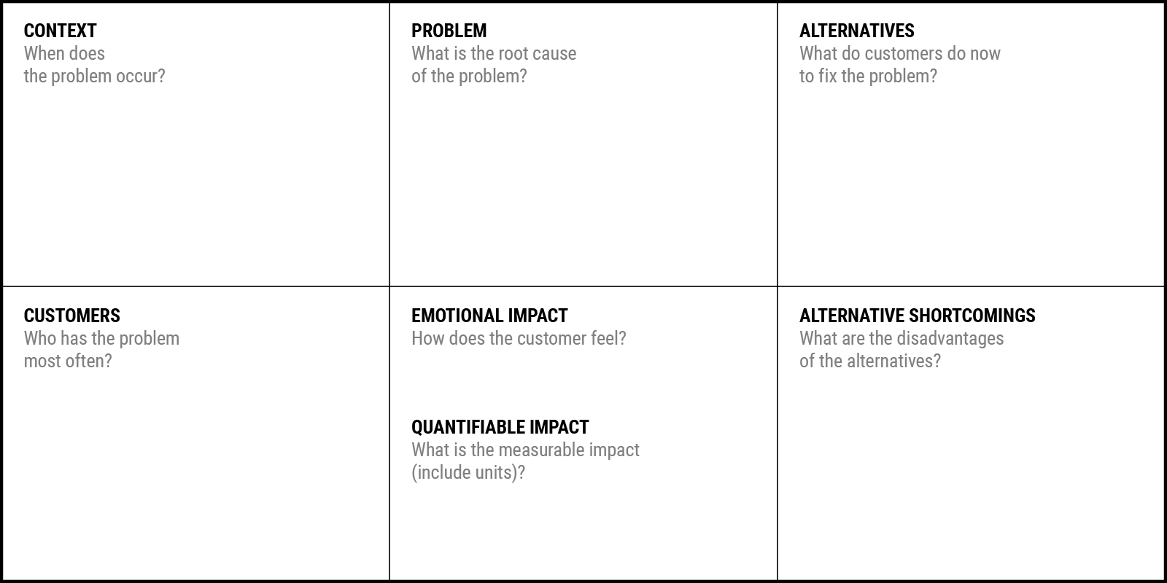
No prior appointments
During peak OPD hours
doctors are delayed due to emergencies
hospitals not provide real-time queue updates
During emergency situations when nearest hospital info is unclear
To get lab reports or prescriptions but must revisit physically
Manual appointment and token systems
No real-time communication between patients and hospital
Lack of digital queue tracking
Poor coordination between departments (clinic, hospital, pathology)
No centralized medical record system
Inefficient bed and facility management
Limited transparency in waiting time
Physically visit hospital early to get token
Call hospital reception to check availability
Wait in long queues
Use WhatsApp/phone calls for appointments
Visit multiple hospitals manually during emergencies
Carry physical medical reports
Ask staff repeatedly for updates
Frustrated due to long waiting, Anxious about health condition, Confused about queue position, Doctors feel overburdened
Regular OPD patients
Elderly patients
Working professionals with limited time
Chronic disease patients (diabetes, BP, etc.)
Emergency patients
Hospital staff managing manual records
Doctors facing overcrowded schedules
Phone booking is unreliable
No real-time updates
Manual records can be lost
Physical visits waste time
No emergency coordination
Lack of integrated system
Poor data tracking and analytics
30–60 minutes average waiting time per patient
20–40% time wasted in queue management
25% patient dissatisfaction rate in busy hospitals
Increased hospital operational inefficiency

Slide 2
Problem Statement
How might we help patients and healthcare providers by providing a smart digital healthcare management platform so they can reduce waiting time, improve transparency, optimize hospital resources, and enhance overall healthcare experience?
Example
How might we –help mess operators--(Help/ Create)-by providing an app facility to fill communication gap between them and students and which also display week-wise menu-(Provide a service / project) so they can –achieve zero waste and bring efficiency in their services-(Value/ benefit)

